Slide 1

Image Classification & Object Detection
Digital Egyptian Pioneers “DEPI” Round 3 Graduation Project

Slide 2
Introduction:
Existing tools are complex or slow.
Users need:
1. Easy-to-use interface
2. Quick predictions
3. High accuracy
4. No technical setup required

Slide 3
Project Goal:
Build a Streamlit web app that allows users to:
Classify the main object in an image & recognize multiple objects

Slide 4

Model Training
For this Project we used two models.
1. MobileNetV2 (Retrained & Applied fine-tuning techniques).
2. YOLO12X (Pretrained)

Slide 5
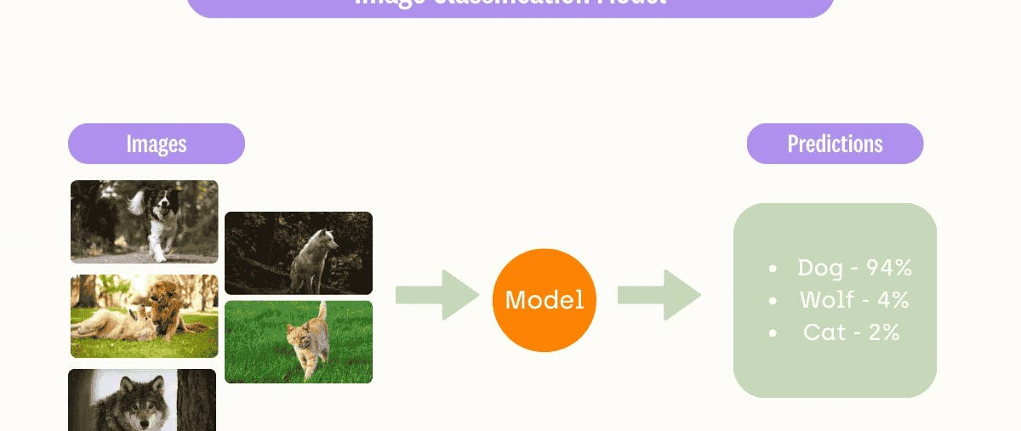
Classification Model
Explaining Classification Model from Architecture to training & predictions

Slide 6
Model Details:
Model Based on MobileNetV2.
Retrained using Transfer Learning (Unfroze the last 50 layers).
Dataset Used: CIFAR10.
Augmentations Applied on the Dataset:
Resizing to 224x224.
Random Flip Horizontal and Vertical.
Random Brightness.
Random Contrast.
Random Rotation.
Random Zoom.
Rescaling (1/255).

Slide 7
Model Details:
Model Based on MobileNetV2.
Retrained using Transfer Learning (Unfroze the last 50 layers).
Dataset Used: CIFAR10.
Training Cycle:
20 Epochs training cycle with Validation stages in-between for a total of 40 epochs (20 each).
Testing cycle.
Final Model Results:
- accuracy: 0.8451 - loss: 0.4446 - val_accuracy: 0.8404.

Slide 8
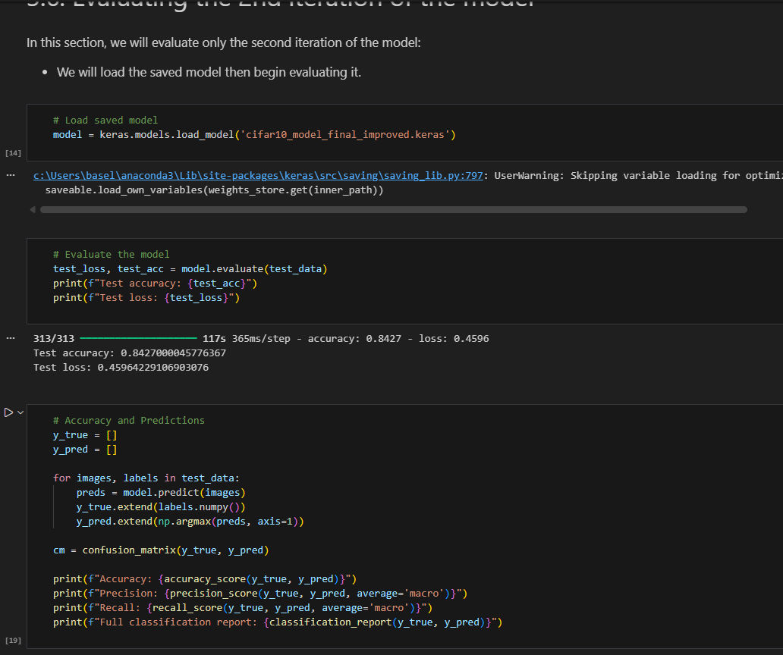
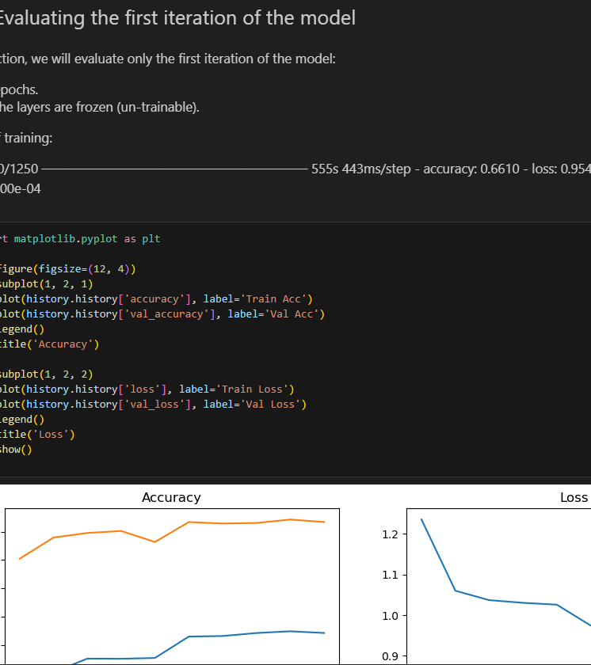
Model Training

Slide 9
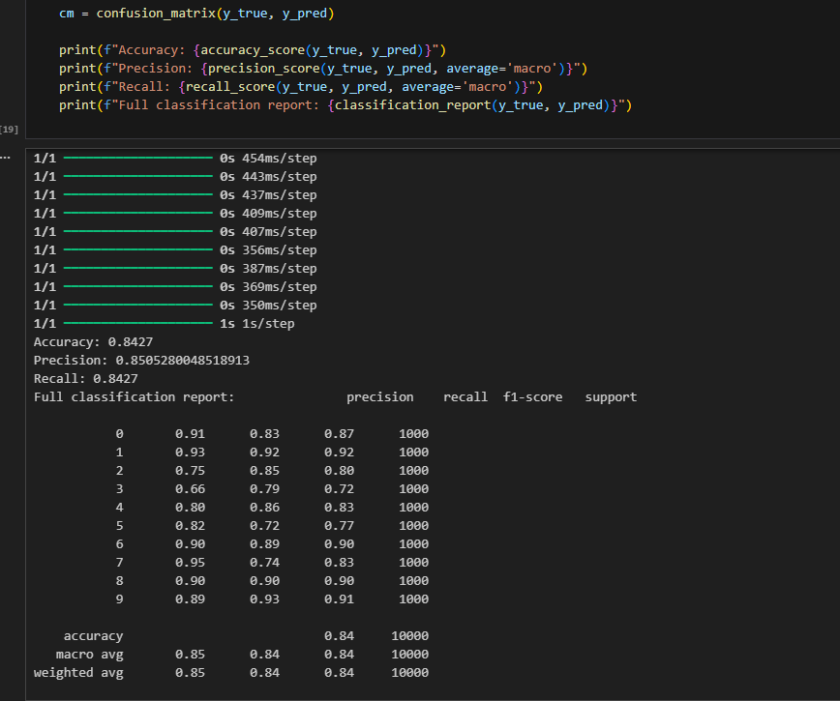
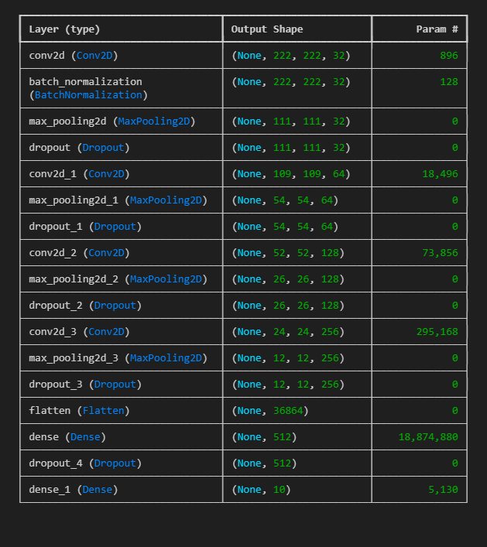
Model Training

Slide 10
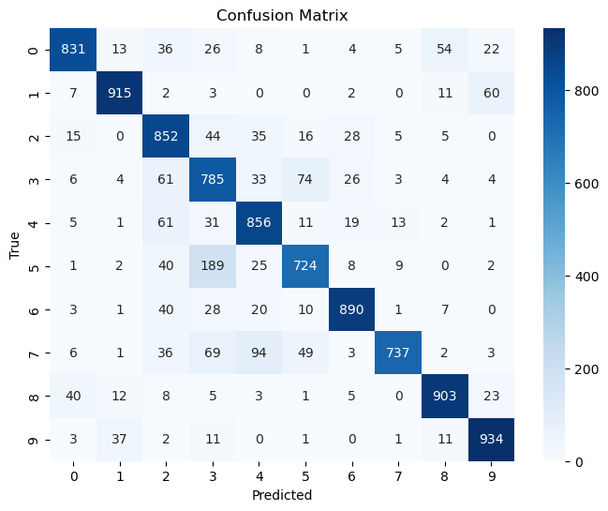
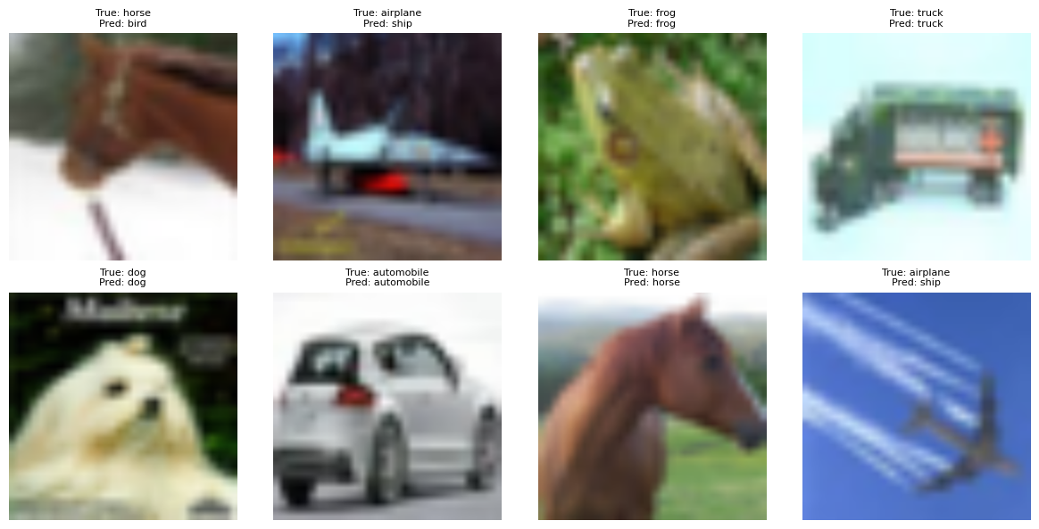
Model Visualizations

Slide 11
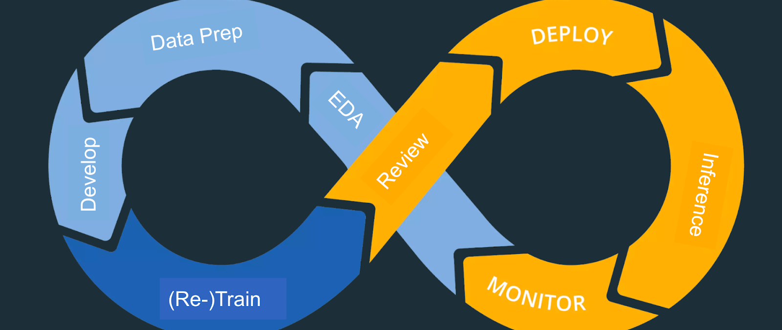
Mlops Implementation with MLflow
End-to-End Model Management & Monitoring

Slide 12
Key Components:
MLflow: Central experiment tracker
Local SQLite: Development tracking database
Custom Monitors: Production performance tracking
Azure Integration: Cloud deployment bridge

Slide 13
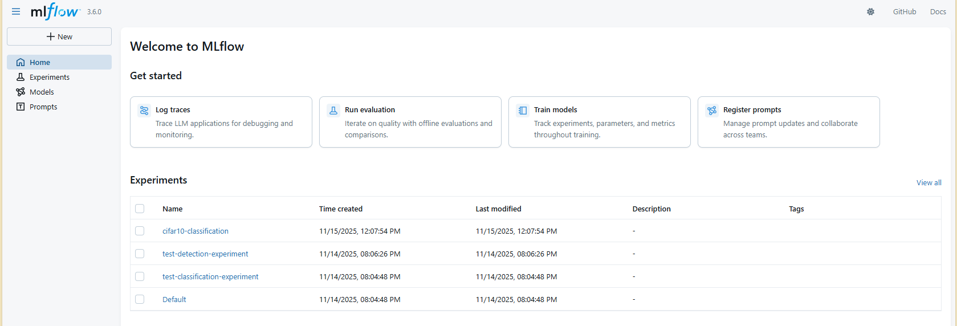
Mlflow UI Images:

Slide 14
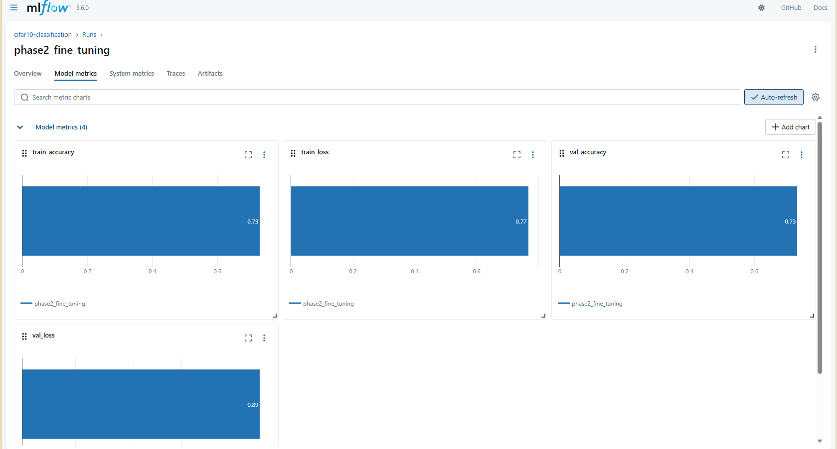
Mlflow UI Images:

Slide 15
Results & Metrics:
Classification Model Performance
1. Final Test Accuracy: 82%
2. Training Time: ~60 minutes (with MLflow tracking)
3. Model Versions: 3+ registered versions
4. Experiments Tracked: 10+ complete runs
Monitoring System
1. Prediction Tracking: Real-time with <100ms overhead
2. Alert Accuracy: 100% in testing scenarios
3. Data Collected: Parameters, metrics, artifacts, predictions
MLOps Maturity
Experimentation
Versioning
Monitoring
4. Documentation

Slide 16

Team Members:
List of Team members and tasks worked on.

Slide 17
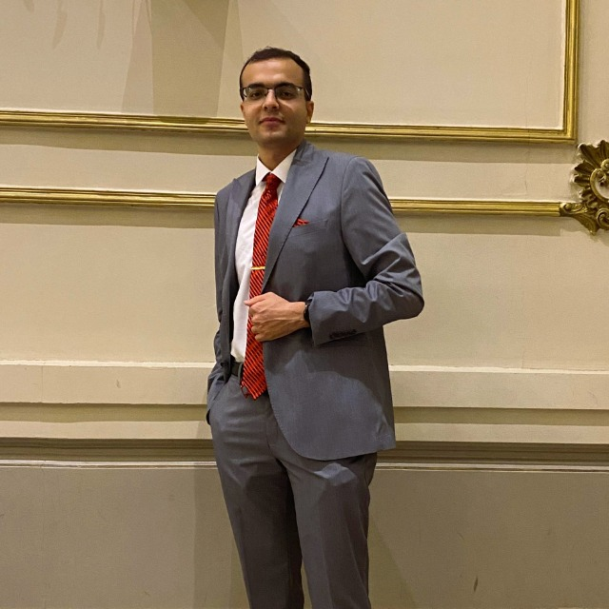
Basel Mohamed Mostafa
Worked on:
Classification Model.
Mlops & Mlflow.

